Slide 1
Database Design Chat 012
Random versus Scrambled

Slide 2
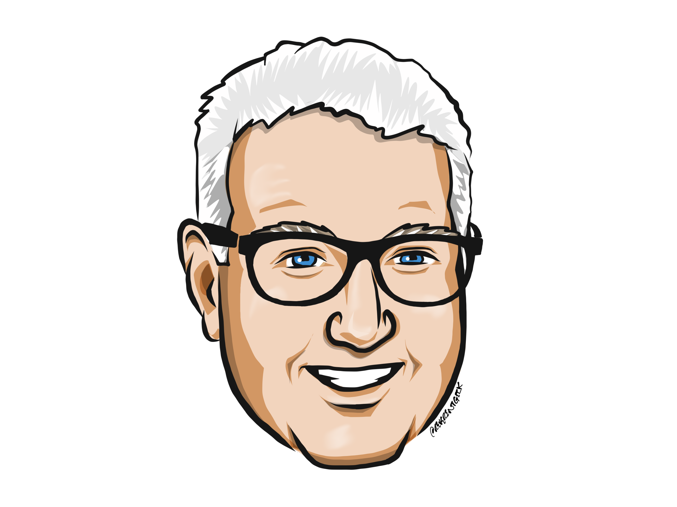
Louis Davidson (drsql)
https://linktr.ee/drsql

Slide 3


Fast is so very relative

Slide 4
What is fast enough?
You can never have your software running too fast..
Unless it affects correctness
Ideally you have SLA (Service Level Agreements) in place to determine adequate response time

Slide 5


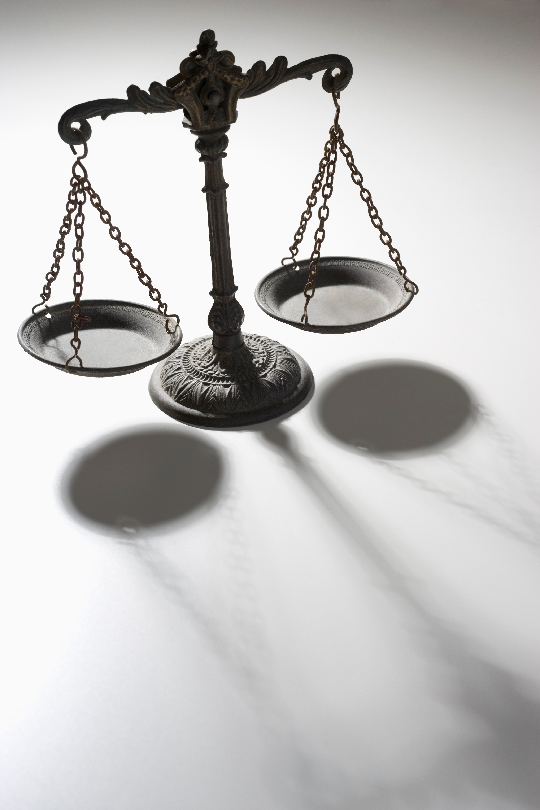

Performance is a Balance
Cost
Need
Correctness
Abilities

Slide 6
Possible performance enhancement value
Example:
Company with 100 employees processing 1000 transactions a day.
Each transaction takes 10 seconds
This is (100 * 1000 * 10) = 1000000 seconds a day
Or approximately: (1000000/60) = 16667 minutes or (16667 / 60) = 277 hours
If you cut that down to 5 seconds a transaction, you could save 138 hours of waiting…
Right?

Slide 7
It depends
On what the employee is doing in those 10 seconds.
If they are waiting on the screen to refresh to do more work, BIG WIN
If it is done in the background, you may have spent too much time
If people costs are N, and equipment costs are N * 2 still may not be worth it.

Slide 8
General Performance
Performance shouldn’t affect the correctness of the code
Easy wins:
Indexes
Better\reconfigured hardware
Less easy:
Code changes
Very hard changes
Changing platforms

Slide 9
Until next time…
Performance is a major concern
Performance starts with proper design
Sadly, proper design often doesn’t occur because software not tested at scale until it is too late
See previous slide about where it is more expensive to fix
Balance Fast enough must still meet the correctness goal, or it isn’t worth it
At all
Not one bit

Slide 10
Questions?
If you have questions, you can:
Comment on YouTube
Email drsql@hotmail.com
Message me on Twitter at drsql
Contact me anywhere on https://linktr.ee/drsql
I may add an episode to discuss or reply directly

